Slide 1
Amazon Web Services Workshop for
System Engineer
Course Outline

Slide 2
Topics
Introduction to this course.
Course objectives and outlines
Pre-requisites.
Topics Covered.
Create AWS Account.

Slide 3
Topics Covered
Introduction to Amazon Web Services.
Amazon Web Services Use Cases.
Amazon Simple Storage Service (S3) and Amazon CloudFront.
Amazon Elastic Cloud Compute (EC2).
Amazon Machine Image (AMI) & Amazon Elastic Block Storage (EBS).
Amazon Elastic Load Balancer (ELB).
Amazon EC2 Auto Scaling.
Amazon Virtual Private Cloud (VPC).

Slide 4
Course Outline
Day1
09:00 - 10:15 Introduction to AWS Products and Services Amazon Web Services Use Cases.
10:15 - 10:30 Break
10:30 - 12:00 Using Amazon Elastic Compute Cloud (EC2)
12:00 - 13:00 Lunch
13:00 - 14:15 Using Amazon Simple Storage Service (S3) & Distribute Web Caching with Amazon CloudFront
14:15 - 14:30 Break
14:30 - 16:00 Using Amazon Elastic Block Storage (EBS)

Slide 5
Course Outline
Day2
09:00 - 10:15 Create Amazon Machine Image (AMI)
10:15 - 10:30 Break
10:30 - 12:00 Configure Amazon Elastic Load Balancer (ELB)
12:00 - 13:00 Lunch
13:00 - 14:15 Configure High Availability with Amazon EC2 Auto Scaling
14:15 - 14:30 Break
14:30 - 16:00 Configure Amazon Virtual Private Cloud (VPC)

Slide 6
Before we start…
WIFI Access Point
SSID: training
Password: its@2013
No proxy server.
Browser :- Firefox or Google Chrome
Firefox plug-ins :- Poster or
Chrome plug-ins :- Advanced REST Client
HTML editor like :- Sublime2, Atom, EditPlus, Notepad++

Slide 7
Create an AWS Account
Goto https://aws.amazon.com and click Create a free Account or Sign in to the Console button.
In the Sign In or Create an AWS Account page. Enter your email address, your email will be AWS user name. Choose I am a new user, or choose I am a returning… if you ever purchased goods from Amazon.
Click Sign in using our secure server button.
Enter all required fields and Captcha, use G-ABLE Address below. Company Name: G-ABLE COMPANY LIMITED Country: Thailand Address: Head Office 127/27, 29-31 Nonsee Road Chongnonsee City: Yanawa State / Province or Region: Bangkok Postal Code: 10120 Phone Number: +6626859000
Click the AWS Customer Agreement check-box, click Create Account and Continue button.

Slide 8
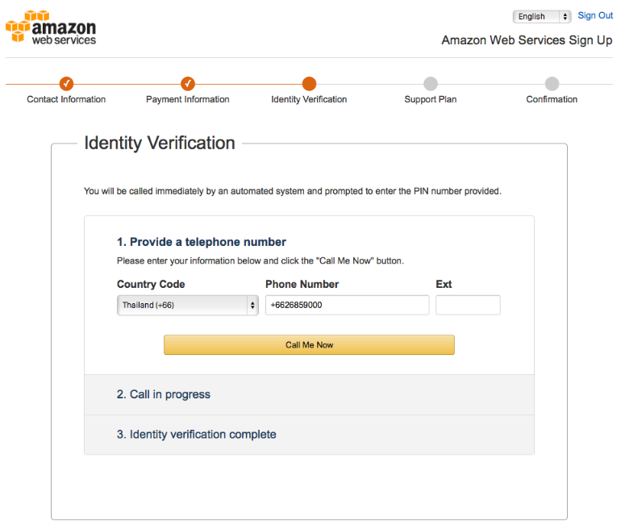
Create an AWS Account
In the Payment Information page, enter Credit Card Number, Expiration Date, and Cardholder’s Name with the information below. Leave billing address as default, Click Continue button. Card Number: xxxx-xxxx-xxxx-xxxx Expire Date: 01 2015 Cardholder’s Name: G-ABLE Co., Ltd.
In the Verification page. Enter your mobile phone number (with out 0, for example:- if your mobile number is 081-000-9999, enter 810009999).
Click Call me now button.

Slide 9
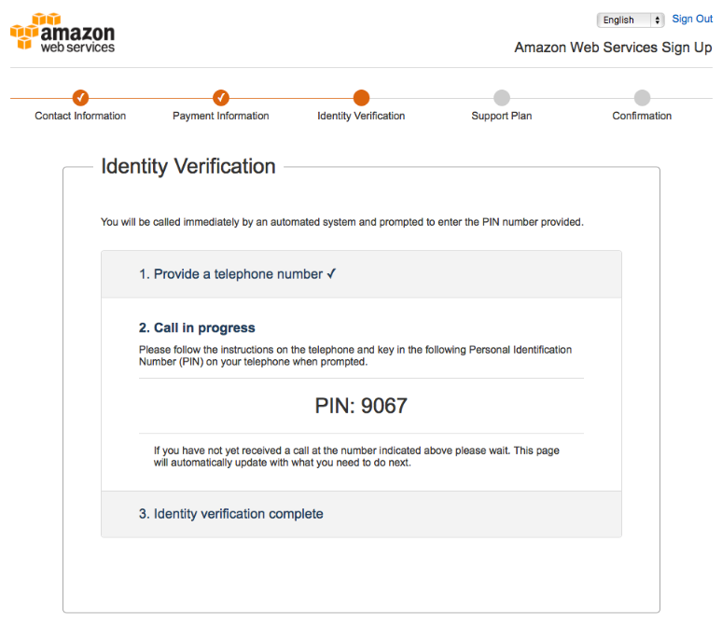
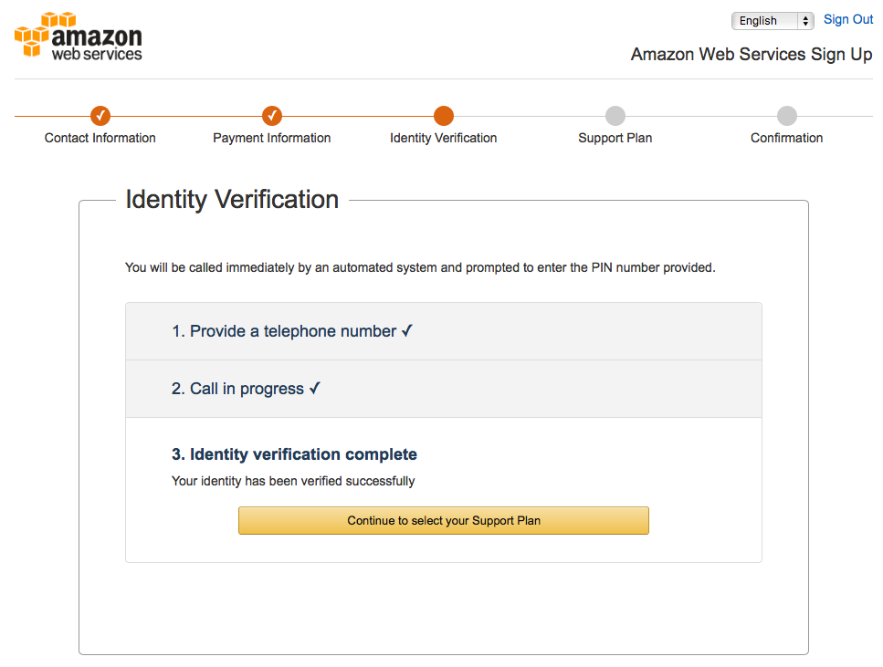
Create an AWS Account
Within a few seconds, AWS automatic caller will call you. After answer the phone, enter the PIN Number that display on the screen with you phone numpad.
Click Continue to select your Support Plan button.

Slide 10
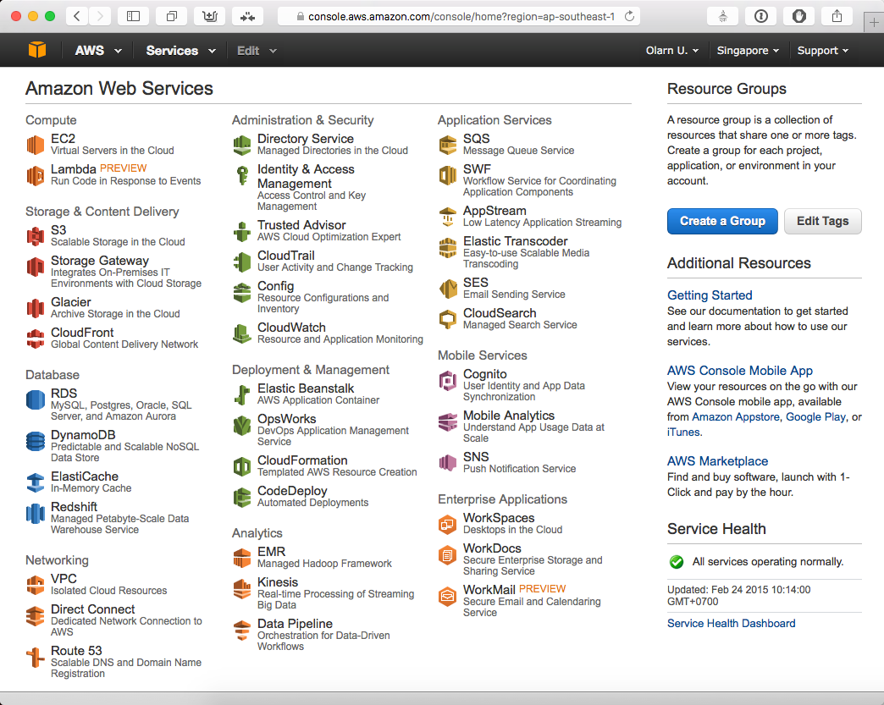
Create an AWS Account
In the Support Plan screen, choose Basic (free) (as default), click Continue button.
Click Launch Management Console button and login to AWS Management Console.

